Slide 1
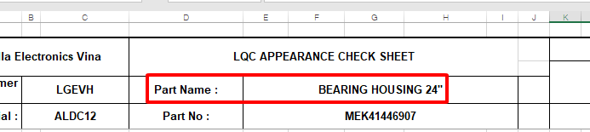
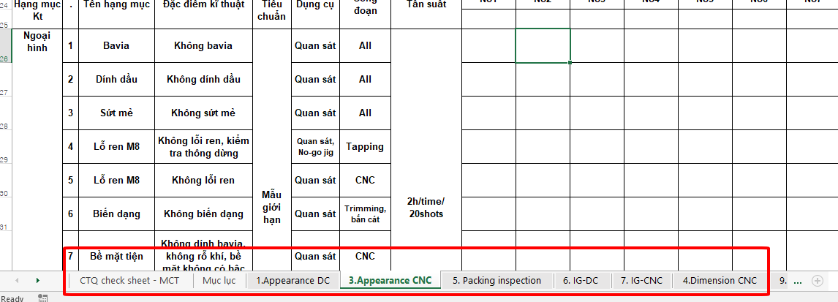
Software request
Display must have options as below:
1) Choose PIC → choose model → choose mold → choose process
PIC: IQC/ LQC/OQC
Model:→ following part name on checksheet
Mold: → have cell for worker input
Process: → following name of sheet on checksheet
2) When choose PIC → choose model → choose mold → choose process → auto show checksheet & worker check & input data by DX task
3) Data must have chart , show data of all sample . Chart have option to choose range inspection date
EX: Model A mold 4 process CNC, PIC : LQC from 8~10th May. Need as below:
Show Upper spec
Show Lower spec
Show data
79.948
…
…
…
79.940
79.945
…
…
…
Sample 1
Sample 2
Sample …
Sample 1
Sample 2
Sample …
Sample 1
Sample 2
Sample …
Date 8th May
Show sample
Date 9th May
Date 10th May
Show inspection date
4) Have history report → can choose & download report to excel , when download can rename
5) Have update history : adding/remove inspection test on checksheet → must show detail update history → have option to input : who update ? When update ? What update ?
6) Have option when input new model → software auto make checksheet

Slide 2
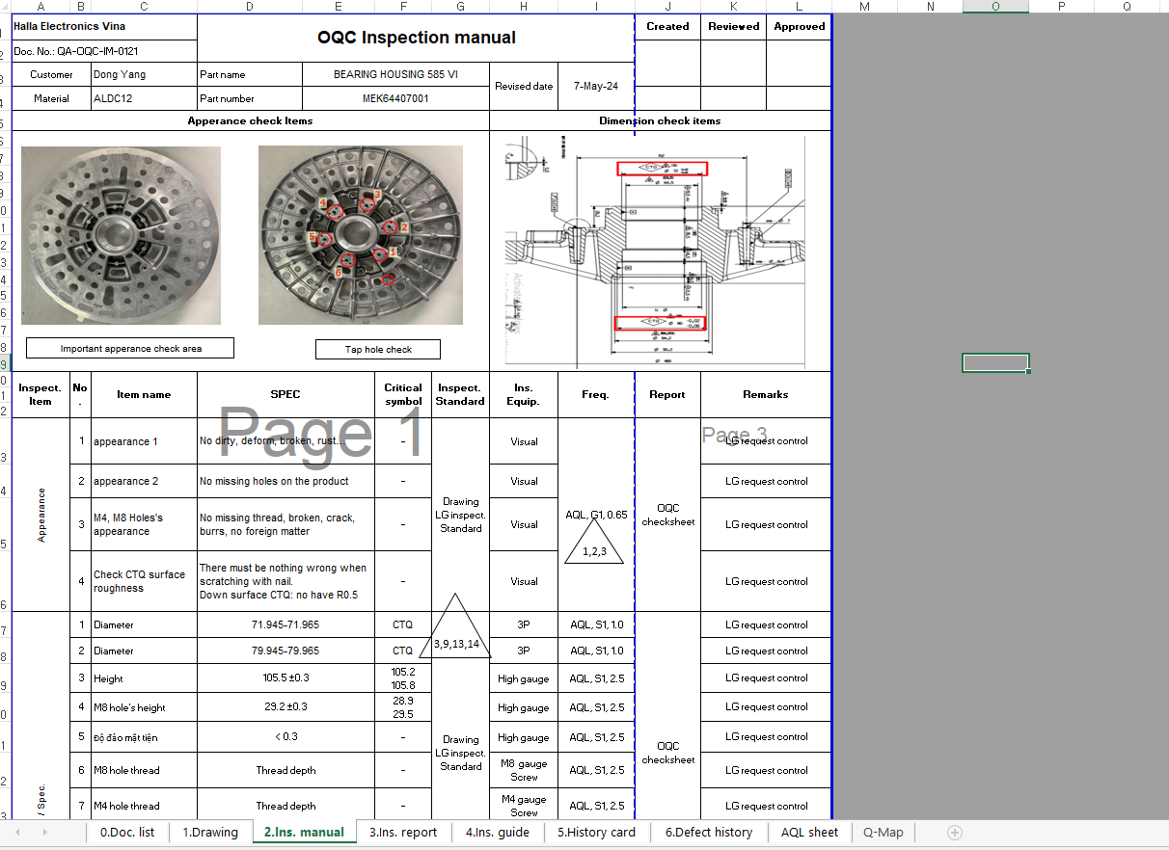
Checksheet
OQC WM

Slide 3
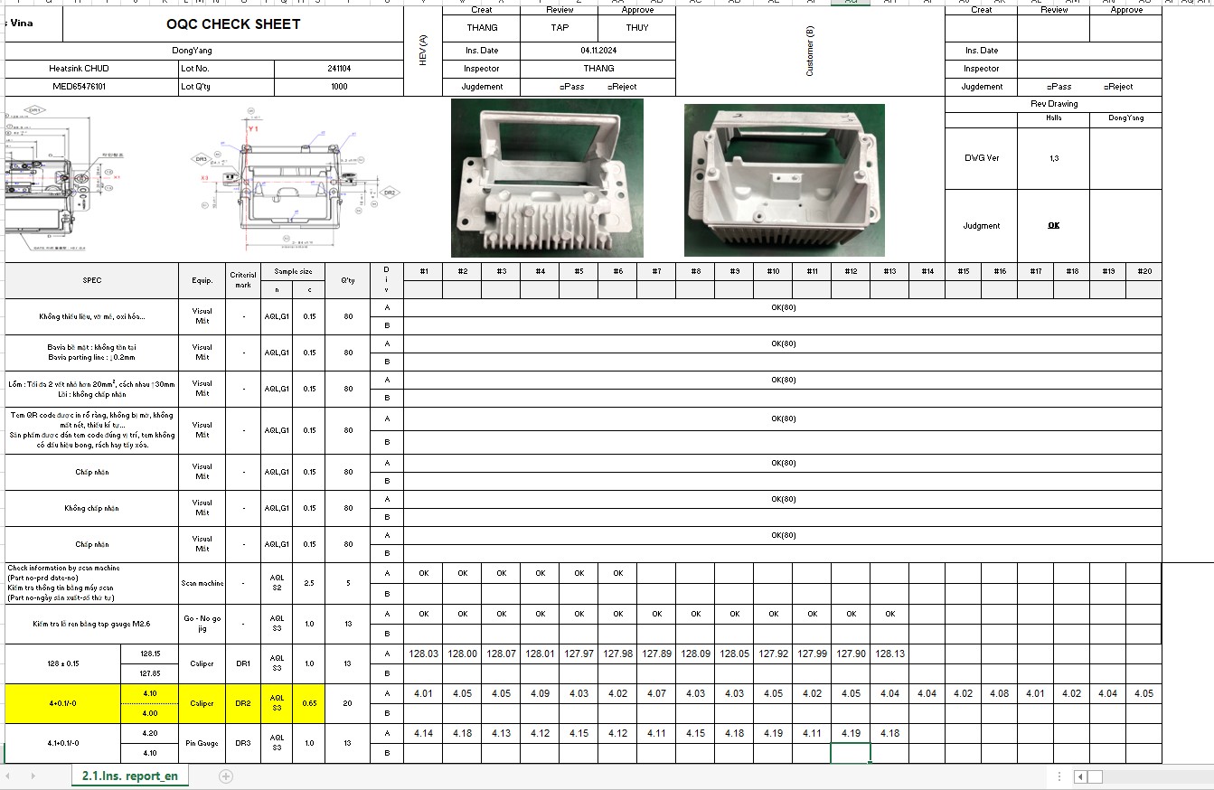
Checksheet
OQC IVI

Slide 4
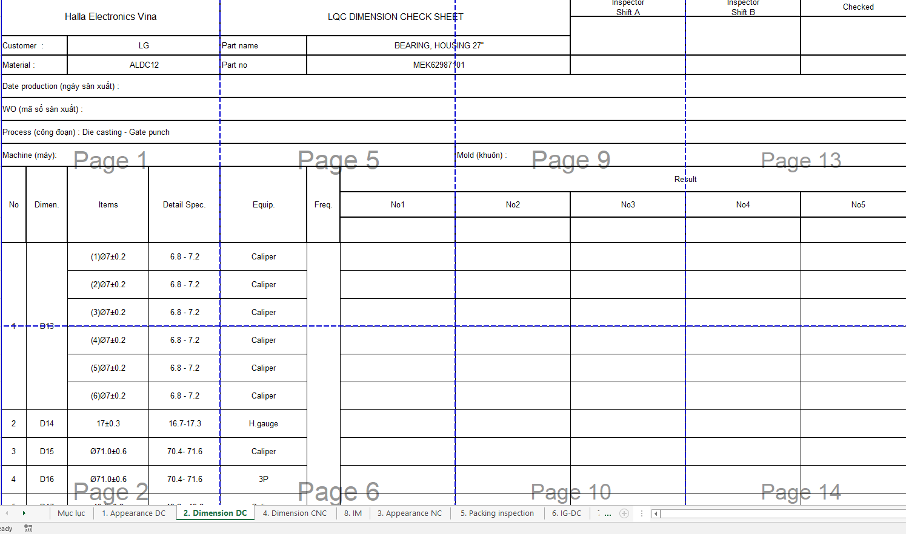
Checksheet
LQC WM

Slide 5
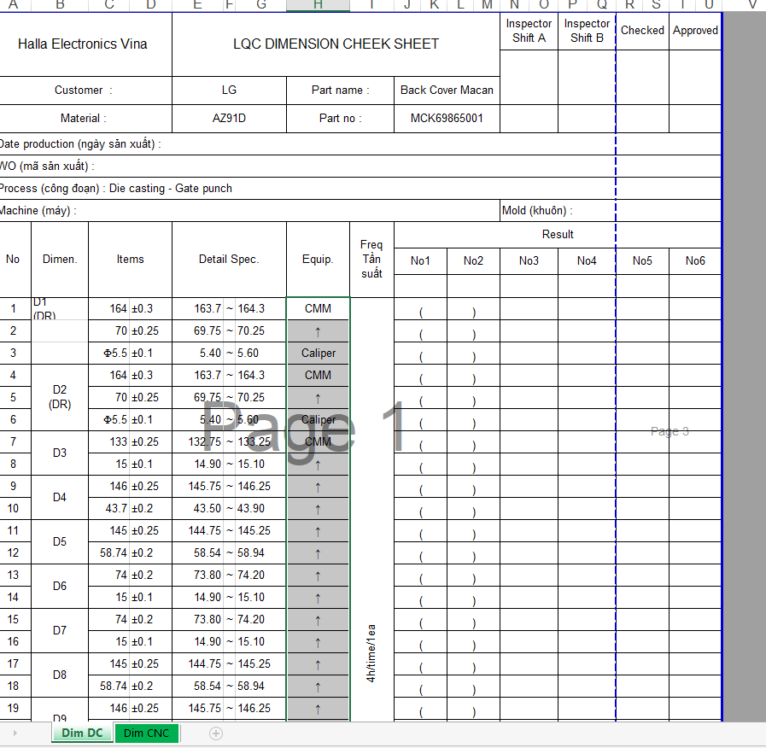
Checksheet
LQC IVI

Slide 6
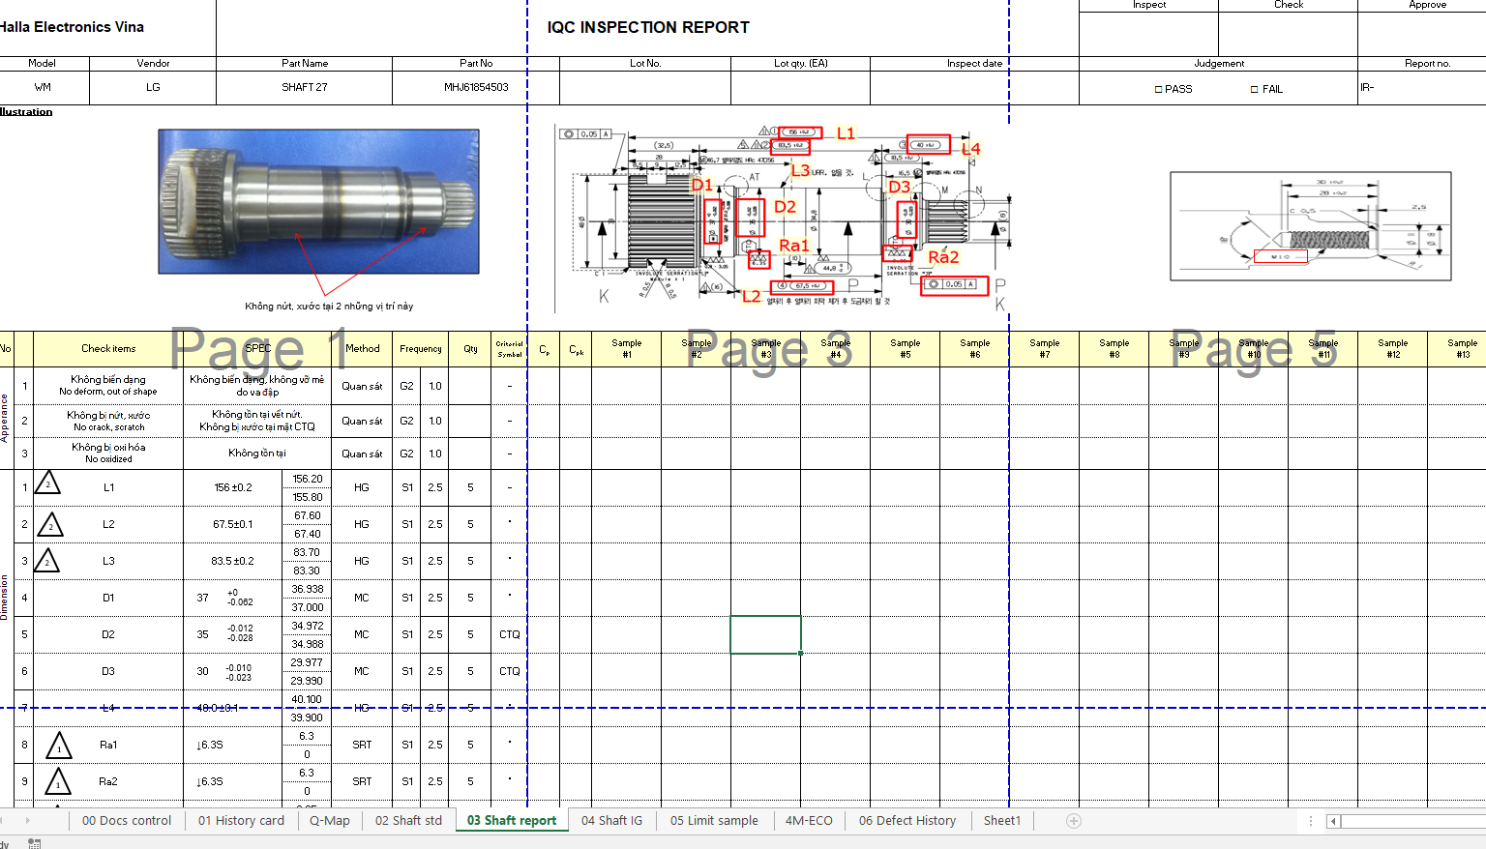
Checksheet
IQC WM

Slide 7
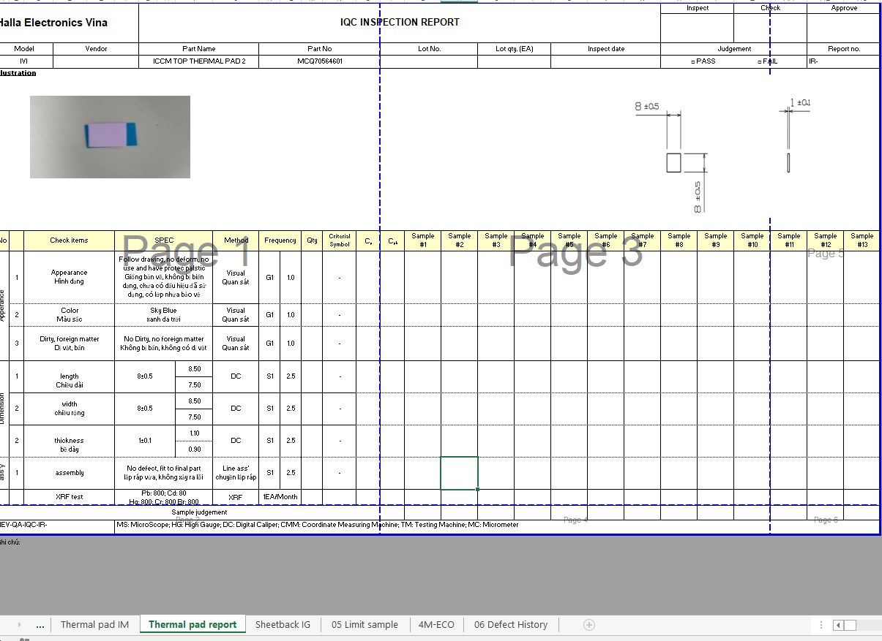
Checksheet
IQC IVI

